Slide 1
TRAUMA AND EMERGENCY
Principles and practices of first aid
Phelix Ogadah. BScN. UEAB
By; Wangao

Slide 2
Topics
Overview of trauma and emergency
Principles of first Aid/ emergency care
Common emergencies and their First Aid
(Asphyxia, Near drowning, Wound/ haemorrhages Epistaxis , Anaphylaxis, Shock, Fracture ,Injured ligaments and muscles, Poisoning, Bites and Stings, Burns and Scalds, Unconsciousness, Foreign bodies)

Slide 3
INTRODUCTION
Trauma and emergency management traditionally refers to care given to patients with urgent and critical needs.
However lack of access to health care facilities may lead to many more people with non-life threatening conditions visiting the emergency department
Therefore, the philosophy of emergency management has broadened to include the concept that an emergency is whatever the patient or the family considers it to be.

Slide 4
INTRODUCTION’…
These include people seeking emergency care for serious life threatening illnesses such as heart conditions
This level of care requires training and practice to be able to manage effectively and efficiently

Slide 5
Introduction’….
The emergency nurse establishes priorities, monitors and continuously assesses acutely ill and injured patients, supports and attends to families, supervises other health personnel, and educates patients and families on their conditions.
Nursing interventions are skilfully performed interdependently with other professionals in an emergency situation,( eg doctors, physiotherapists etc).

Slide 6
Definitions:
Trauma-(Pathology)-Wound or shock produced by sudden physical injury as from violence or accident.
Unintentional or intentional wound or injury inflicted on the body from a mechanism against which the body cannot protect itself
Psychiatric trauma-An experience that produces psychological injury or pain
Emergency care-(is care that must be rendered without
delay)- Is the initial treatment given to acutely ill patients coming to the health facility without prior plan; (emergency department), usually presenting with life threatening illnesses and injury

Slide 7
Definitions con’…
Triage-The word triage comes from the French word trier, meaning “to sort.” Routinely, triage is used to sort patients in the Emergency Department into groups based on the severity of their health problems and the immediacy with which these problems must be treated or managed.
Triage systems- Assessment is hierarchical based on the potential for loss of life; and has four basic categories: emergent, urgent, non-urgent and fast tract
Notes:
Triage is an advanced skill that requires training to be able to classify different illnesses and injuries to ensure that patients most in need of care promptly receive it.

Slide 8
Definitions cont’…
Emergent patients have the highest priority—their conditions are life threatening, and they must be seen immediately.
Urgent-patients have serious health problems, but not immediately life threatening ones; they must be seen within 1 hour.
Non-urgent-patients have episodic illnesses that can be addressed within 24 hours without increased morbidity .

Slide 9
Definitions cont’…
“fast-track.”-These patients require simple first aid or basic primary care. They may be treated in the ED or safely referred to a clinic or general out patient department or physician’s office.
Field triage use colours RED,YELLOW, GREEN and BLACK. (Brunner &Suddarth's page 2187, table 72-1) NOTE-Routine ED triage protocols differ significantly from the triage protocols used in disasters and mass casualty incidents (field triage).
Routine hospital triage directs all available resources to the patients who are most critically ill, regardless of potential outcome.
In field triage (or hospital triage during a disaster), scarce resources must be used to benefit as many people as possible.

Slide 10
Resuscitation-An act of restoring one to a stable health status from unconsciousness or from the brink of death
Disaster- Sudden serious event or situation with a negative impact on health and life of the people, overwhelming the ability of the local system to cope, requiring immediate action.

Slide 11
Principles of first aid/Emergency care
Triage-Sort patients as per priority of risk potential
A- Airway
B- Breathing
C- Circulation
D-Disability
S- Safety-The nurse must consider her safety in the process of helping a patient/use of personal protective equipment/waste management.

Slide 12
Primary survey
Primary Survey- the initial quick assessment done on the patient to establish the medical problem and start care.
Take a quick history, collect crucial initial data: vital signs, neurologic assessment findings, and diagnostic data as necessary.

Slide 13
Cont.…
DR.ABCD
D- danger; protect yourself and the client
R- response; call the patient ‘MR/MRS can you hear me”
A- airway; positioning & spine stabilization, suctioning, intubation
B- breathing; assess, look, listen feel, oxygen, mechanical ventilation
C- circulation; inverted J
D- defibrillation/ deformity, shocking patient at QRS, ventricular tachycardia.
S- safety; consider infection prevention at every stage.

Slide 14
Cont.…
A- alert, is the patient conscious,
V- voice, the patient response to voice when called.
P- pain, the patient responds when pain is inflicted
U- unresponsive, the patient is in coma and doesn’t respond to stimuli.

Slide 15
Secondary survey
Secondary survey-detailed assessment of the patient after he has been stabilized.
Use the following acronym during secondary survey assessment- SAMPLE
Signs and symptoms
Allergies
Medicines
Previous medical/surgical history
Last meal eaten and quantity
Events, history

Slide 16
Inspection
Deformities
Contusions
Ablations- change in color
Penetrations/ punctures
Burns
Tenderness
Lacerations
Swellings

Slide 17
Secondary survey cont’…
Obtain a complete health history
P/E; head-to-toe assessment-examination,
Diagnostic and laboratory testing and other advanced medical procedures included in the secondary survey.
The following questions reflect the minimum information that should be obtained from the patient or from the person who accompanied the patient to the ED and document all the responses
for reference.

Slide 18
Secondary survey cont’…
What were the circumstances, precipitating events, location, and time of the injury or illness?
When did the symptoms appear?
Was the patient unconscious after the injury or onset of illness?
How did the patient get to the hospital?
What was the health status of the patient before the injury or illness?
Is there a medical or surgical history, a history of admissions to the hospital?

Slide 19
Possible questions cont’…
Is the patient currently taking any medications, especially hormones, insulin, digitalis, anticoagulants?
Does the patient have any allergies, if so, what are they?
Does the patient have any bleeding tendencies?
When was the last meal eaten and the quantity taken? (This is important if general anaesthesia is to be used or if the patient is unconscious, or in suspected poison)

Slide 20
Common Emergencies And Their First Aid:
Asphyxia
Near drowning
Wound/ haemorrhages Epistaxis
Anaphylaxis
Shock
Fracture
Injured ligaments and muscles
Poisoning, Bites and Stings
Burns and Scalds
Unconsciousness
Foreign bodies

Slide 21
Burns Shock Unconsciousness Wounds/ Hemorrhages
Assignment

Slide 22
1.Asphyxia (suffocation or choking)
Definition-a situation or state of reduced oxygen supply to the body tissues due to interrupted breathing as occurs when the airway is partially or completely blocked by (food particles, secretions or other foreign objects) strangulation
Types-mild, moderate and severe
Causes of asphyxia
Food particles
Secretions
Foreign objects

Slide 23
Causes of asphyxia Cont’…
Drowning
Gas or smoke inhalation during fire accidents
Accidental coverage of the nose and mouth by a piece of plastic
Accidental or intentional strangulation
being trapped in a confined spaces with no ventilation

Slide 24
Pathophysiology
Airway obstruction is caused by aspiration of foreign bodies, anaphylaxis, viral, bacterial infections, inhalation or chemical burns.
In adults, aspiration of a bolus meat is the most common cause while in children it is caused by small toys, buttons and other objects in addition to food, conditions like peritonsillar abscesses, epiglottitis and other acute infectious processes of the posterior pharynx can result in airway obstruction

Slide 25
Solid particles eg. food
Emergency response in choking (in complete airway obstruction) by food is through performing the Heimlich manoeuvre or abdominal thrust which dislodges the foreign object and re-establish a clear airway.
Stand behind the client
Wrap your hands around client’s waist
Make a fist with one hand placing the thumb side of the hand against the client’s abdomen. (the fist should be placed midline below the xiphoid process and lower margins of the rib cage and above the umbilicus

Slide 26
Heimlich Cont’…
Perform quick upward distinct thrusts to the client’s abdomen.
Each thrust should be separate and discrete (a conscious patient can sit during the procedure)
Repeat the process six to ten times until the client expels the foreign body
If procedure fails-patient develops respiratory distress or complete blockage call for help

Slide 27
Heimlich Cont’…
If patient becomes unconscious proceed as follows:
Position patient in supine, kneel astride the client’s abdomen, with the fist hand as per previous explanation and perform quick upward thrusts into the diaphragm ,repeat 6 to 10 times and apply a finger sweep with each thrust.
Use one hand to grasp the lower jaw and tongue using the thumb and fore fingers to lift.
This move will open the mouth and pull the tongue away from the back of the throat.
With the other index finger of the other hand into the client’s mouth next to the cheek use a hooking motion to dislodge the foreign body if it is visible.

Slide 28
Airway Obstruction
Definition: this is the partial or complete occlusion of the airway which may be acute or chronic.
Acute upper airway obstruction is a life-threatening medical emergency.
If the airway is completely obstructed, permanent brain damage or death will occur within 3 to 5 minutes due to secondary hypoxia.

Slide 29
Pathophysiology
Airway obstruction is caused by aspiration of foreign bodies, anaphylaxis, viral, bacterial infections, inhalation or chemical burns.
In adults, aspiration of a bolus meat is the most common cause while in children it is caused by small toys, buttons and other objects in addition to food, conditions like peritonsillar abscesses, epiglottitis and other acute infectious processes of the posterior pharynx can result in airway obstruction

Slide 30
Airway Cont’..
Partial obstruction of the airway can lead to progressive hypoxia, hypercapnia, and respiratory and cardiac arrest.
For an emergent or urgent health problem stabilize, provide critical treatments, and promptly transfer the patient to the appropriate setting i.e. intensive care unit, operating room, general care unit which are the priority areas of emergency care.
Although initiation of treatment is at the ED, ongoing definitive treatment of the underlying problem is provided in other settings, and the sooner the patient is stabilized and moved to the specific area, the better.

Slide 31
Causes of airway obstruction
Aspiration foreign bodies,
anaphylaxis,
viral or bacterial infection,
Trauma
inhalation or chemical burns.
In adults, aspiration of a bolus of meat is the most common cause of airway obstruction.
Notes:
Upper airway obstruction has a number of causes

Slide 32
Causes Cont’…
In children, small toys, buttons, coins, and other objects are commonly aspirated in addition to food.
Peritonsillar abscesses,-abscess between the capsule of the tonsil and the pharynx
Epiglottitis', and other acute infectious processes of the posterior pharynx can result in airway obstruction.

Slide 33
Clinical Presentation of airway obstruction
Common signs and symptoms:
Choking
Apprehensive appearance
Inspiratory and expiratory stridor,
Laboured breathing,
Use of accessory muscles (supra-sternal and intercostal retraction),
Flaring nostrils,
Increasing anxiety,
Restlessness, and confusion.
Cyanosis and loss of consciousness develop as hypoxia worsens.

Slide 34
Assessment and Diagnostic Findings
Look, Listen, Feel
Assessment of the patient who has a foreign object occluding the airway may involve simply asking the person whether he or she is choking and requires help.
If patient is unconscious, inspection of the oropharynx may reveal the obstructing object.
X-rays, laryngoscopy, or Bronchoscopy also may be done.

Slide 35
Management
The ED staff work collaboratively and follow the ABCD (airway, breathing, circulation, disability) method:
Establish a patent airway.
Provide adequate ventilation, employing resuscitation measures when necessary to ensure patient breathing (rising and falling of chest-if not test breathing by placing the back of hand close to patient’s mouth, if breathing, a stream of warm air will be felt on it.
(Trauma patients must have the cervical spine protected and chest injuries assessed first.)

Slide 36
1.Head- tilt-chin-lift-maneuver
Patient is placed supine on a firm flat surface
Airway is opened by either head-tilt-chin-lift or the jaw thrust maneuver
Head tilt chin lift which helps to tilt the head back should be used only if it is determined that the patients cervical spine is not injured

Slide 37
2.Jaw thrust maneuver
The angle of the patients lower jaw are grasped and lifted displacing the mandible forward.
It is a safe approach to opening the airway of a victim with suspected neck injury because it can be accomplished without extending the neck.

Slide 38
Abdominal thrust maneuver
Referred to as the Heimlich maneuver according to the American Heart Association. This is done on a conscious patient. The following steps:
Stand behind the person who is choking.
Place both arms around the person’s waist.
Make a fist with one hand with the thumb outside the fist.
Place thumb side of fist against the person’s abdomen above the navel and below the xiphoid process.
Grasp fist with other hand.
Quickly and forcefully exert pressure against the person’s diaphragm, pressing upward with quick, firm thrusts.
Apply thrusts 6 to 10 times until the obstruction is cleared.
The pressure from the thrusts should lift the diaphragm, force air into the lungs, and create an artificial cough powerful enough to expel the aspirated object

Slide 39
Artificial Airways
Endotracheal tube
Tracheostomy
Pharyngeal airways

Slide 40
3.Oropharyngeal airway insertion
A semi circular tube inserted over the back of the tongue into the lower posterior pharynx in a patient breathing spontaneously but unconscious.
It prevents the tongue from falling back and obstructing the airway.

Slide 41
4.Endotracheal intubation
The main purpose of endotracheal intubation is to establish and maintain the airway in patients with respiratory insufficiency/hypoxia
Indications are:
To establish airway for patients who cannot be adequately ventilated with an oropharyngeal airway
To bypass an upper airway obstruction
To prevent aspiration
To permit connection of the patient to a resuscitation bag/Mechanical ventilator
To facilitate the removal of tracheobronchial secretions

Slide 42
Cricothyroidotomy
It is the opening of the cricothyroid membrane to establish an airway.
It is used in emergency situations in which endotracheal intubation is either not possible or contra indicated eg in airway obstruction from laryngeal edema, hemorrhage to the neck tissue or obstruction of the larynx.

Slide 43
2.Cardiopulmonary Resuscitation
Definition-A basic emergency procedure for life support undertaken in cardiac arrest to manually preserve intact brain function, restart and restore spontaneous blood circulation , consisting of artificial ventilation and manual external cardiac message.
Purpose
1) To restore cardiopulmonary function
2) prevent irreversible brain damage

Slide 44
Indications
Respiratory failure (Pulse present but patient not breathing)
Drowning
Electric/ hypovolemic shock
Anaphylactic reaction
Drug overdose
Cardiac arrest
Asphyxia

Slide 45
Assessment
1) Client’s state of consciousness to confirm need for resuscitation
2) Breathing-look, listen, feel
3) Pallor-to determine state of oxygenation
Planning and preparation for patient and self
Review knowledge on CPR and organize for resuscitation team and trolley

Slide 46
Requirement
Emergency trolley with:
Syringes with needles –assorted sizes
Functional laryngoscope with assorted blades (adult and child)
Ambo bags and face masks (adult and child/infant)
Endotracheal tubes assorted sizes
Torch
Suction catheters-assorted sizes
Naso-gastric tube

Slide 47
Requirement cont.,..
Oxygen source
Gloves
Infusion equipment
Splints/hard fracture boards/Firm surface
Airways
Cannulae assorted sizes
Scissors
Adhesive tapes or strapping
Defibrillator/mechanical ventilators/cardiac monitors

Slide 48
Implementation
Three Ss in emergency response
Safety
Stimulation
Shout for help (for teamwork)
Put on gloves
Lay the casualty on firm surface in supine position without a pillow for ease of external chest compression during cardiac message
Assess for breathing and ensure airway is clear-Open airway by using head tilt or jaw thrust Manoeuvre to establish and maintain airway to ensure ventilation

Slide 49
Insert the oropharyngeal airway to prevent obstruction by the tongue (prevents tongue from falling back)
Perform oropharyngeal suction if secretion present to clear airway and prevent aspiration.
If patient not breathing connect ambo bag and give two rescue breaths as you check for chest expansion.
Then connect oxygen as you place face mask over nose and mouth appropriately

Slide 50
Palpate or feel for carotid pulse in adults and children and or brachial for infants for 5-10 seconds to confirm blood circulation.
If pulse is absent start chest compression to stimulate the heart and restore circulation:
Place heel of one hand over lower third of sternum, other hand on top, straighten elbows over shoulders perpendicular to patient’s chest.

Slide 51
For Children
Place heel of one hand on lower half of the sternum above xiphoid process
Maintain head tilt
For infant place index and middle finger of one hand on the lower half of the sternum above xiphoid process.
Fingers be kept 1cm below nipple line and not slanted

Slide 52
Combine cardiac compression with artificial breaths as follows:
30 cardiac compressions to 2 respirations for adult (30:2)
For infants and children 15 compressions to 2 rescue breaths (15:2).
For new-borns (3:1)
Start an intravenous line and infuse to facilitate circulation
Give medications as indicated

Slide 53
Signs and Symptoms
i) if the casualty/client is conscious he will usually grasp the anterior neck and being unable to speak or cough.
ii) Anxiety and apprehension
iii) Cyanosis
iv) Stridor-a harsh crowing sound made on inhalation caused by constriction of the airway, may also occur in severe allergic reactions
Grunting-sound like air moving through fluid

Slide 54
Management
Goal of management
i) Restore adequate breathing
ii)Remove the agent causing obstruction
iii) Remove patient from source of danger eg in smoky area.
Asphyxia or choking can be fatal if immediate relief is not achieved.
The management depends on the cause.

Slide 55
3.Near-drowning
Near-drowning is survival for at least 24 hours after submersion.
The most common consequence is hypoxemia.
Drowning is one of the leading causes of unintentional death in children younger than 14 years of age. An estimated 7000 drownings and 90,000 Children younger than 4 years of age account for 40% of drowning (Suominen et al., 2002).

Slide 56
Factors associated with drowning and near-drowning include:
Alcohol ingestion, inability to swim, diving injuries, hypothermia, and exhaustion
Efforts to save the victim should not be abandoned prematurely.
Notes:
submersion in cold water. This is possible because of a decrease
in metabolic demands or the diving reflex.

Slide 57
Near drowning cont’….
After resuscitation, hypoxia and acidosis, are the primary problems of a victim who has nearly drowned, this require immediate intervention.
Resultant pathophysiologic changes and pulmonary injury depend on the type of fluid (fresh or salt water) and the volume aspirated.
Fresh water aspiration results in a loss of surfactant, hence an inability to expand the lungs.

Slide 58
Near drowning cont’….
Salt water aspiration leads to pulmonary oedema from the osmotic effects of the salt within the lung.
After a person survives submersion, acute respiratory distress syndrome resulting in hypoxia, hypercapnia, and respiratory or metabolic acidosis can occur.

Slide 59
Management
Therapeutic goals include maintaining cerebral perfusion and adequate oxygenation to prevent further damage to vital organs.
Immediate cardiopulmonary resuscitation is the factor with the greatest influence on survival.
The treatment goal- prevention of hypoxia, is accomplished by ensuring an adequate airway and respiration, thus improving ventilation (which helps to correct respiratory acidosis) and oxygenation.

Slide 60
Management
Arterial blood gas analyses are performed to evaluate oxygen, carbon dioxide, and bicarbonate levels and pH.
These parameters determine the type of ventilatory support needed.
Use of endotracheal intubation with positive pressure ventilation improves oxygenation, prevents aspiration, and corrects intrapulmonary shunting and ventilation.

Slide 61
Complications
Shock
Respiratory arrest
Cardiac arrest
Brain damage
Renal failure

Slide 62
Prevention
Avoid open water sources/containers (for children)
Avoid excessive exhaustive swimming activities
Avoid deep waters especially for novices in swimming
Those unskilled should not engage in swimming without skilled assistance
Use of life saving jackets.

Slide 63
4.Anaphylaxis
It is also known as type 1 or immediate hypersensitivity
Occurs in the first encounter or exposure to immunogen
Mediated by Ig E, basophils and mast cells
Has three phases
Sensitization
Activation
Effector

Slide 64
Sensitization
Occurs in first encounter with an antigen
B cells internalizes the allergen, process and present it to the CD4 cells (Helper T cell)
T helper cell secrets interleukin iv (IL4) which activates humoral response
IL4 makes B cells to go clonal expansion and differentiation making it to switch from Ig M to Ig E
Ig E then binds to Mast cells and basophils
Sensitization then occurs when Ig E is bound to basophils and mast cells
It affects susceptible individuals

Slide 65
Activation
Second exposure to the same antigen/ allergen
The allergen does not bind to the B cell but binds to FCE receptor on mast cells and basophils
It cross links two Ig E
The cell is activated and begins to synthesize leukotrienes C4 and D4

Slide 66
Effector phase
Future exposure to the same antigen
Mast cells and basophils undergo degranulation
Preformed and newly formed substances are produced, eg histamine, leukotrienes, serotonin and heparin
This causes, vasodilatation, reduced BP, constriction of smooth muscles (bronchus), vascular permeability- edema, stimulation of goblet cells increased secretion of mucous
Death can occur in 10 minutes
Allergens include, proteins, drugs, foods, insect products, plants pollen, fur/ hair, dust mold spores etc

Slide 67
Prevention
Identify the allergen
Avoid the allergen
Use of drugs
Antihistamine- block histamine receptors
Cromoglycate based drugs- destabilizes the mast cells
Catecholamine- adrenaline (stimulates autonomic nerve action) for penicillin allergy.
Desensitization- giving a small dose of the antigen to an individual to switch Ig E to Ig G.

Slide 68
5.Poisoning
Organophosphate poisoning (OPP)
They are compounds used in both domestic and industrial use eg insecticides, pesticides, herbicides, anthelminthic, nerge gases
Suicidal attempts occurs via exposure intentionally or unintentionally

Slide 69
Pathophysiology
The phosphate compounds can be absorbed into the body by ingestion, injection, inhalation or cutenously.
They then inhibit acetylcholinesterase
Acetylcholine (neurotransmitter) is then degraded hence no transmission of impulses

Slide 70
Clinical presentation
Signs and symptoms can be divided into three categories as follows;
Muscarinic effects
Nicotinic effects
CNS effects

Slide 71
Muscarinic Effects
Salivation
Lacrimation
Urination
Defecation
GIT symptoms; emesis,
Diaphoresis
Meosis
Bronchospasm

Slide 72
Nicotinic Effects
Muscle cramping
Muscle weakness
Muscle fasciculation; brief involuntary, spontaneous muscle contractions

Slide 73
CNS Effects
Confusion
Impaired memory
Psychosis
Restlessness
Tremors
paralysis
coma
Vital signs
Depressed respiration
Bradycardia
Hypotension
Tachycardia
Tarchypnoea
Hypoxia

Slide 74
Management of OPP
AIMS
Identify the poison
Proper airway and oxygenation
Administer antidote
Prevent PUD, coma and aspiration pneumonia
Prevent RDS due to bronchospasms, bronchorrhea and laryngeal spasms
DR.ABCD

Slide 75
Atropinazation
Atropine is anticholinergic preparation
Give 1mg IV ¼ hourly until dilatation of pupils is achieved
IV fluids infusion full-balst, monitor input output
End point is reached when;
Pupils are fully dilated
Secretions are dry
Symptoms are reversed

Slide 76
Management cont.
Use activated charcoal
Gastric lavage should be done within 30 minutes of poisoning
Consider corrosiveness of poison
Benzodiazepines for convulsions and seizers
Mgso4 (magnesium iv sulphate), administered for acetylcholine functioning
Monitor urine output, respiration and other vital signs
Keep the patient warm

Slide 77
6.Shock

Slide 78
7.Fracture
A fracture may be a complete break in the continuity of a bone or, occasionally, it may be incomplete.

Slide 79
Pathophysiology
When the bone is broken, adjacent structures are also affected, resulting in soft tissue edema, hemorrhage into the muscles and joints, joint dislocations, ruptured tendons, severed nerves, and damaged blood vessels.
Body organs may be injured by the force that caused the fracture or by the fracture fragments.

Slide 80
Clinical features
Pain at site of injury
Swelling due to hematoma formation
Loss of function due to pain and deformity
Deformity depending on force and muscle tissue surrounding muscles e.g. angulation, shortening of extremity
Bleeding due to ruptured blood vessels

Slide 81
Classification
Fracture may be subdivided, according to their etiology, into four basic groups
Fracture caused solely by sudden injury
Fragility fractures
Fatigue or stress fracture
Pathological fractures
They are also classified according to:
Location
Type
Direction or pattern of fracture line

Slide 82
Bone Healing Process
After a fracture, bone healing follows a number of stages:
A hematoma forms between surrounding soft tissues.
Inflammatory process sets in with accumulation of macrophages. This takes about five days. The macrophages, phagocytose the hematoma. Growth of granulation tissue begins.
Callus formation, the osteoblasts secrete non-lamellar osteoid. Calcium is also absorbed which aids in hardening of bone to form callus.
Remodeling, osteoclasts become active removing excess callus and opening up a medullary canal in callus. This may take up to one month.

Slide 83
Bone Healing Process
Factors enhancing bone healing:
Adequate nutrition
Adequate blood supply
Absence of infection

Slide 84
Bone Healing Process
Factors hindering bone healing:
Presence of infective organisms e.g. streptococci
Fat embolism in medullary canal
Excessive bone tissue fragments
Deficient blood supply
Continued mobility (lack of proper reduction and immobilization)
Age - old age due to slowing
Nature of injury
Type of bone lost
Degree of immobilization

Slide 85
Principle Management of Fractures (First Aid)
The emergency management of a fracture involves: (DR.ABCD.RICE)
Assessing the airway, breathing and circulation
Assessing any bleeding sites and controlling bleeding
Treatment of any life threatening injury
Immobilization by use of splints
Applying cold compresses
Elevating the extremity
Minimizing mobility
Monitoring the patient closely
Refer casualty to hospital for further management

Slide 86
Injured ligaments and muscles
Sprain is an injury to joints (ligaments)
Strain is an injury to muscles (tendons)
Review anatomy of joints

Slide 87
First Aid
Identify type of injury
Reassure the casualty
Rest the injured part
Apply ice to the area
Compress the area, apply crepe bandage
Elevate the affected limb
Avoid weight bearing to the affected limb
Refer to hospital for, x-ray, cast application if indicated and also for anti-inflammatory therapy

Slide 88
8.Bites and Stings
Bites caused by animals
Stings caused by insects
S&S
Swelling
Redness
Pain
Bleeding
Infection

Slide 89
8.1.Dog Bite
Clean the bitten area using warm water and clean thoroughly
Puncture wounds should be irrigated with a sterile catheter using methylated spirit and povidone.
Iodine is also virucidal and may be used to clean the wound
Calm the casualty
Find out if the dog was vaccinated
Go to hospital for antirabies
Follow the dog for 10 days
Dress the wound
Bite wounds should not be sutured immediately to prevent more traumas from the suturing needle, which will increase the areas for viral entry into the body tissue.
Suturing may be done 24 to 48 hours after the bite using very few sutures under the cover of anti-rabies serum locally.

Slide 90
Pathology of Rabies
Rabies is a serious viral disease of canines which is incidentally transmitted to humans by the bite of a rabid animal. It is caused by a virus known as lassa virus type I.
This happens when humans get bitten by a rabid animal (dog/cat/bat)or when its saliva comes into contact with the mucous membranes or open wound of a person
All warm blooded animals are susceptible to rabies.

Slide 91
Anti- Rabies Vaccine
This is a very safe and effective treatment following a rabid animal bite.
The vaccine HDCV (Human Diploid cells tissue Culture Vaccine) is administered in six doses sub-cutaneous as follows:
One ml immediately after exposure (day 0),
One ml on day 3,
One ml on day 7,
One ml on day 14,
One ml on day 30,
One ml on day 90
In order to prevent wound infection and tetanus you should give the patient broad spectrum antibiotics

Slide 92
8.2.Human Bite
Clean the area using warm water
Dress using sterile dressing
Seek medical help
Do not stich the wound immediately

Slide 93
8.3.Snake bite
Identify the type of the snake and describe
Green mamba- the most dangerous, gives neurotoxin impairing the CNS and the brain
Cobra-
Bloom slang- hemotoxic, impairs blood clot features appear within 24 hour
Python-
Puff ada-
Calm the patient, put on gloves, head raised (to slow Venus return),irrigate the area, clean area using soap and warm water(to minimize infection), dress the area, apply pressure on the either side,
do not tie coz of ischemia,
Do not suck, cut the wound
Transfer patient to hospital.

Slide 94
9.Burns and Scalds
Destruction of the skin sometimes with underlying tissues by extremities of temperature, exposure to electrical, chemical and radiation sources.
Classification of burns is usually according to size(wallace rule of 9) and depth(superficial partial, deep partial thickness and full thickness

Slide 95
Etiology
Fire
Boiling water
Hot objects or oil
Electrical shocks
Chemicals and acids
Radiations
Geothermal/ steam

Slide 96
Pathophysiology
Every system is affected by thermal injury.
The extent of dysfunction is proportional to the total body surface area(TBSA)involved.
The systemic response to burn injury is biphasic, with early hypofunction followed rapidly by hyperfunction. However, the organ function gradually returns to normal as the wound heals or is surgically grafted.

Slide 97
Skeletal System
Red bone marrow replaces red blood cells which is destroyed by the burnt skin. If the burns area is too large for the bone marrow to compensate for the loss in red blood cells, the patient will require blood transfusions to survive.
Cardiovascular System
Burning of the skin will lead to an increase in capillary permeability, which causes an increase in blood vasculature – this then results in a decrease of blood pressure as well as live blood volume. This further decreases the blood flow and oxygenation to tissues, which then also results in edema, shock and eventually death.

Slide 98
Respiratory System
Airway obstruction caused by gross edema of the throat. Also, these patients may have an increased respiratory rate as a result of pulmonary edema (secondary to smoke inhalation) or increased respiratory rate as an attempt to compensate the increased metabolic rate.
Endocrine System
Increased secretions of adrenaline and nor-adrenaline in response to the injury may lead to increased body temperature and increased cell metabolism.
Lymphatic System
Inflammation increases as a result of damaged tissue, which results in greater strain on the lymphatic system and pitting edema.

Slide 99
Immune System
Decreased response as a result of excessive strain on the lymphatic system and due to increased infection as a result of burns area removing the first line of infection defense.
Digestive
Due to the potential hypovolaemic state in which a body with severe burns is likely to be in, their is a decrease in blood availability in the intestinal lining and liver. The intestinal lining automatically increases nutrients required to support metabolism and repair of damaged cells.
Urinary
The kidneys compensate for the increased fluid loss as a result of the burn area by decreasing urine output. The potential detriment of this change is the potential for kidney damage as a result of poor perfusion.

Slide 100
Clinical manifestations
A superficial burn destroys the epidermis, and appears red and dry. Pain is due to damage to the cutaneous nerve endings.
A partial thickness burn destroys the epidermis and part of the dermis and appears red and blistered. It causes pain due to the exposure of the nerve endings to the air.
A full thickness burn destroys the dermis and may be extended to the subcutaneous tissue, muscle or bone. the skin may appear white, brown,or black and leathery. Often there is no pain present as the nerve endings have been destroyed.

Slide 101
Phases of burn care
Emergent/immediate resuscitative
This is from onset of injury to completion of fluid resuscitation.
Priority activities here include, first aid, prevention of shock, prevention of respiratory distress, detection and treatment of concomitant injury wound assessment and initial care.

Slide 102
Phases of burn care
Acute phase: from beginning of diuresis to near completion of wound closure. it entails wound care and closure, prevention or treatment of complications including infections and nutritional support.
Rehabilitation: from major wound closure to return to individuals optimal level of physical and psychosocial adjustment. Prevention of scars and contracture, physical, occupational and vocational rehabilitation, functional and cosmetic reconstruction and psychosocial counseling

Slide 103
Emergency Burns Management
Aims are;
to save lives, minimize disabilities and prepare patient for definitive care.
First priority is to secure and protect the airway.
inhalation injury is suspected for patients with history of facial burns and exposure to closed room fires, risk of carbon monoxide poisoning is increased thus patient should be intubated.100% oxygen is administered.

Slide 104
10.Unconsciousness

Slide 105
11.Foreign bodies
in, ears
Eyes
Nose
Private organs
Throat (fish bone)

Slide 106
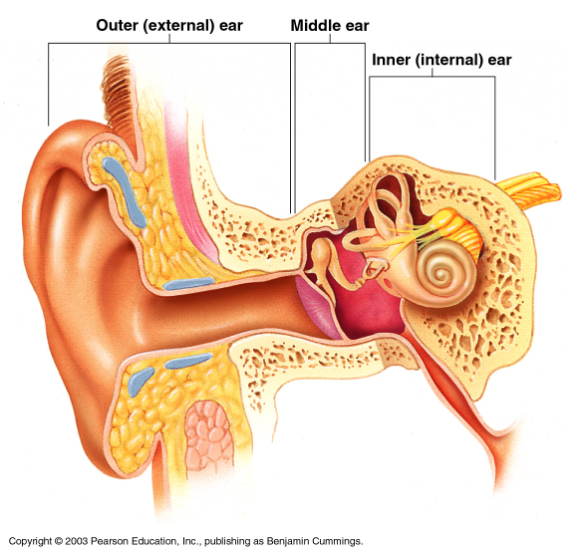
Anatomy of the Ear
The ear is divided into three areas
Outer (external) ear
Middle ear
Inner ear

Slide 107
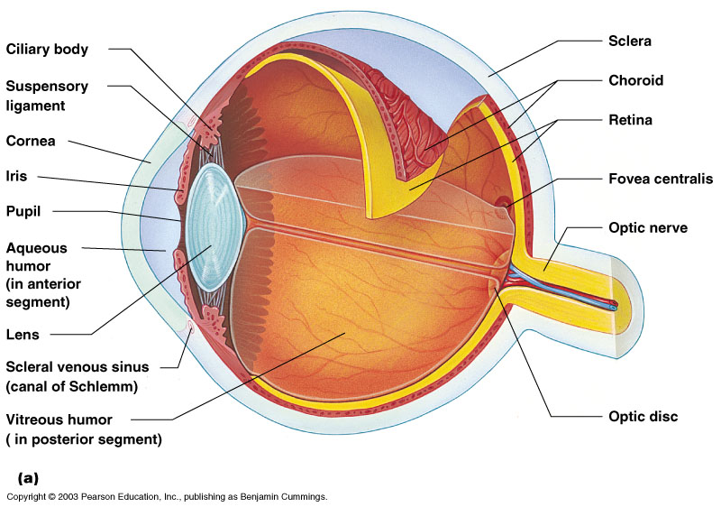
Structure of the Eye
The wall is composed of three tunics
Sclera & Cornea fibrous outside layer
Choroid – middle layer
Sensory tunic – (retina) inside layer

Slide 108
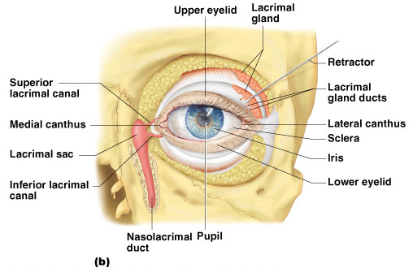
Accessory Structures of the Eye
Eyelids
Meets at medial and lateral canthus
Eyelashes

Slide 109
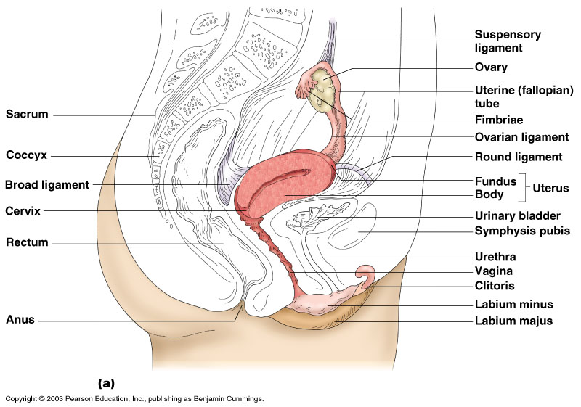
Female Reproductive System
Figure 16.8a
Copyright © 2003 Pearson Education, Inc. publishing as Benjamin Cummings
Slide 16.21b

Slide 110
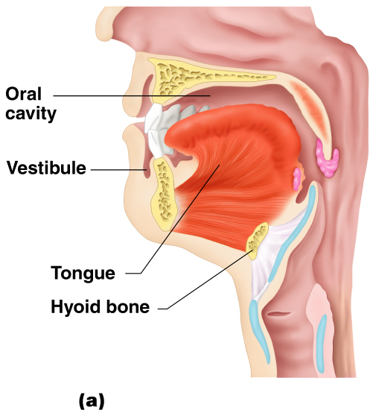
Mouth (Oral Cavity) Anatomy
Foreign body
In the throat

Slide 111

END

